Slide 1
Cause of Death
Submitted by:
Sonali Kadam

Slide 2
About Dataset
In this Dataset, we have Historical Data of different cause of deaths for all ages around the World. The key features of this Dataset are: Meningitis, Alzheimer's Disease and Other Dementias, Parkinson's Disease, Nutritional Deficiencies, Malaria, Drowning, Interpersonal Violence, Maternal Disorders, HIV/AIDS, Drug Use Disorders, Tuberculosis, Cardiovascular Diseases, Lower Respiratory Infections, Neonatal Disorders, Alcohol Use Disorders, Self-harm, Exposure to Forces of Nature, Diarrheal Diseases, Environmental Heat and Cold Exposure, Neoplasms, Conflict and Terrorism, Diabetes Mellitus, Chronic Kidney Disease, Poisonings, Protein-Energy Malnutrition, Road Injuries, Chronic Respiratory Diseases, Cirrhosis and Other Chronic Liver Diseases, Digestive Diseases, Fire, Heat, and Hot Substances, Acute Hepatitis

Slide 3
Name of Columns
01. Country/Territory - Name of the Country/Territory
02. Code - Country/Territory Code
03. Year - Year of the Incident
04. Meningitis - No. of People died from Meningitis
05. Alzheimer's Disease and Other Dementias - No. of People died from Alzheimer's Disease and Other Dementias
06. Parkinson's Disease - No. of People died from Parkinson's Disease
07. Nutritional Deficiencies - No. of People died from Nutritional Deficiencies
08. Malaria - No. of People died from Malaria
09. Drowning - No. of People died from Drowning
10. Interpersonal Violence - No. of People died from Interpersonal Violence
11. Maternal Disorders - No. of People died from Maternal Disorders
12. Drug Use Disorders - No. of People died from Drug Use Disorders
13. Tuberculosis - No. of People died from Tuberculosis
14. Cardiovascular Diseases - No. of People died from Cardiovascular Diseases
15. Lower Respiratory Infections - No. of People died from Lower Respiratory Infections
16. Neonatal Disorders - No. of People died from Neonatal Disorders
17. Alcohol Use Disorders - No. of People died from Alcohol Use Disorders

Slide 4
18. Self-harm - No. of People died from Self-harm.
19. Exposure to Forces of Nature - No. of People died from Exposure to Forces of Nature
20. Diarrheal Diseases - No. of People died from Diarrheal Diseases
21. Environmental Heat and Cold Exposure - No. of People died from Environmental Heat and Cold Exposure
22. Neoplasms - No. of People died from Neoplasms
23. Conflict and Terrorism - No. of People died from Conflict and Terrorism
24. Diabetes Mellitus - No. of People died from Diabetes Mellitus
25. Chronic Kidney Disease - No. of People died from Chronic Kidney Disease
26. Poisonings - No. of People died from Poisoning
27. Protein-Energy Malnutrition - No. of People died from Protein-Energy Malnutrition
28. Chronic Respiratory Diseases - No. of People died from Chronic Respiratory Diseases
29. Cirrhosis and Other Chronic Liver Diseases - No. of People died from Cirrhosis and Other Chronic Liver Diseases
30. Digestive Diseases - No. of People died from Digestive Diseases
31. Fire, Heat, and Hot Substances - No. of People died from Fire or Heat or any Hot Substances
32. Acute Hepatitis - No. of People died from Acute Hepatitis

Slide 5
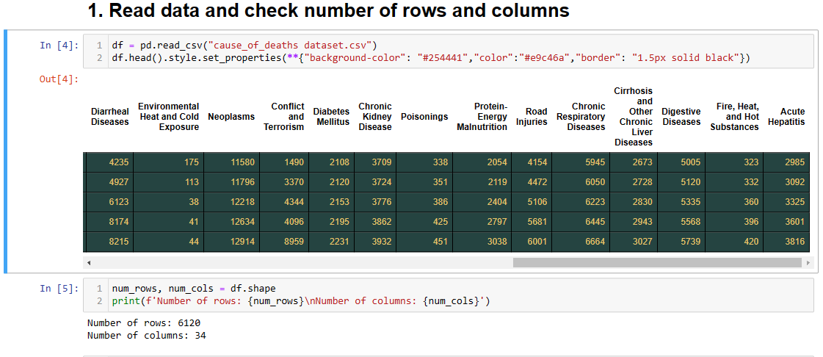

Slide 6
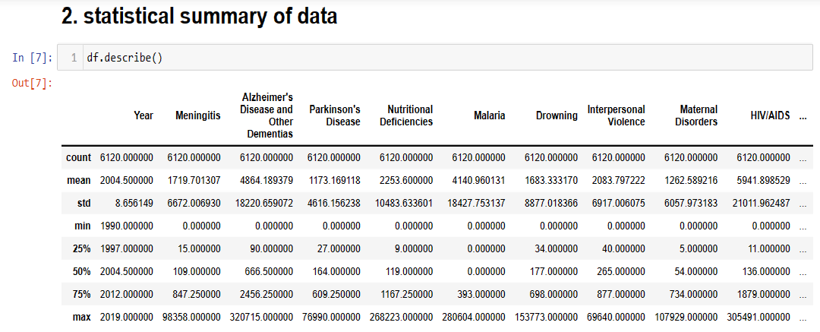

Slide 7


Slide 8
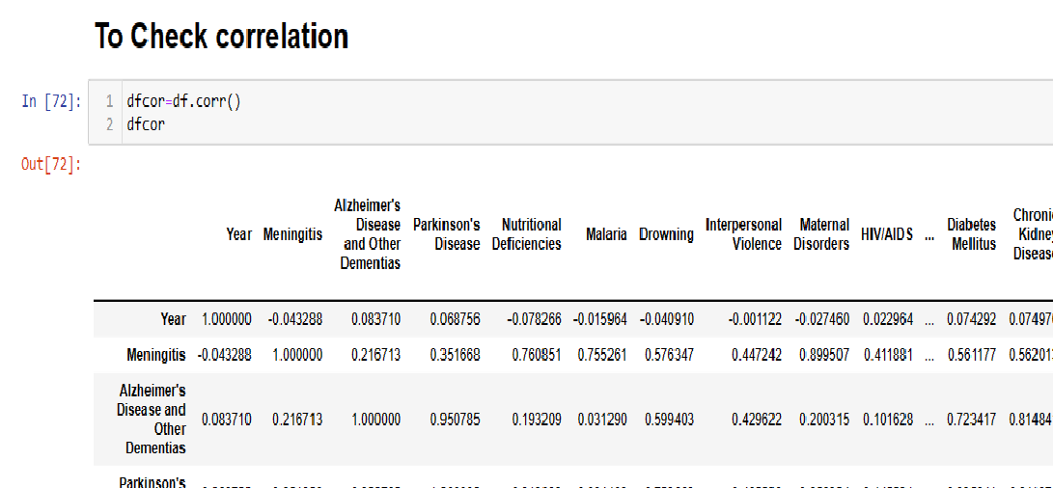

Slide 9
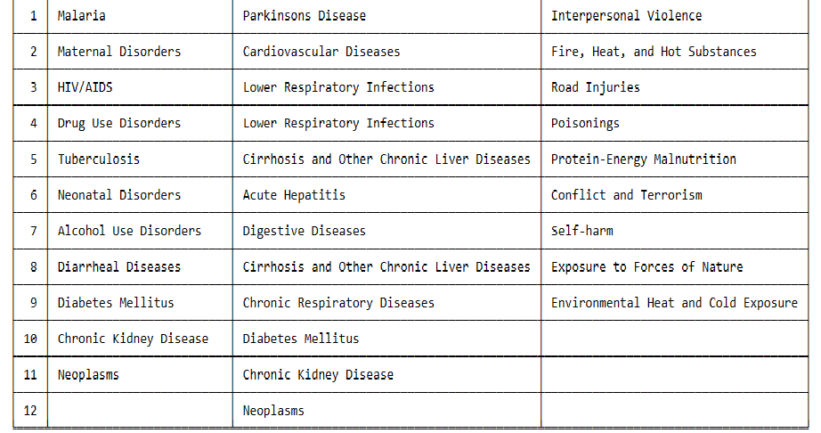
Diseases classification:

Slide 10
EDA Steps & Visualizations

Slide 11
During the 30 years from 1990 to 2019, the following trends were observed:
The number of deaths from non-communicable diseases always accounts for the highest rate and tends to increase gradually.
The number of deaths from communicable diseases accounts for the lowest rate, and maintains a fairly stable number over the years.
The number of deaths from injures accounts for a high rate, but tends to decrease.

Slide 12
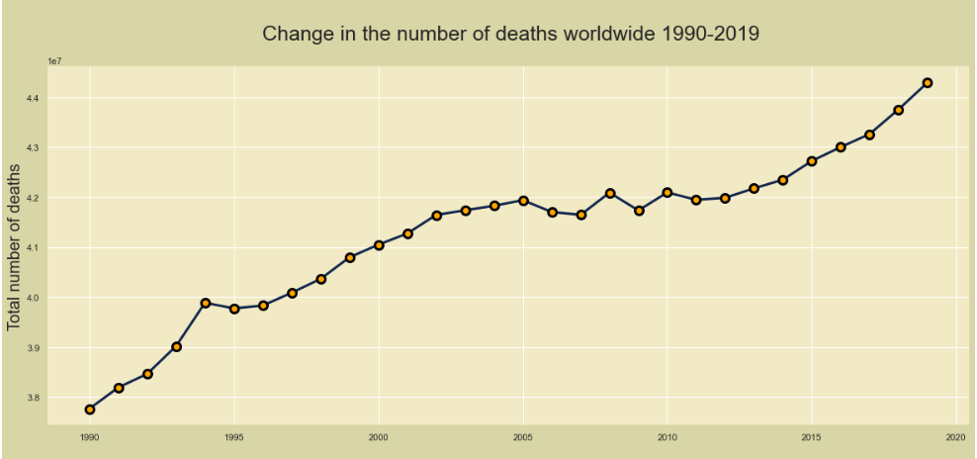

Slide 13
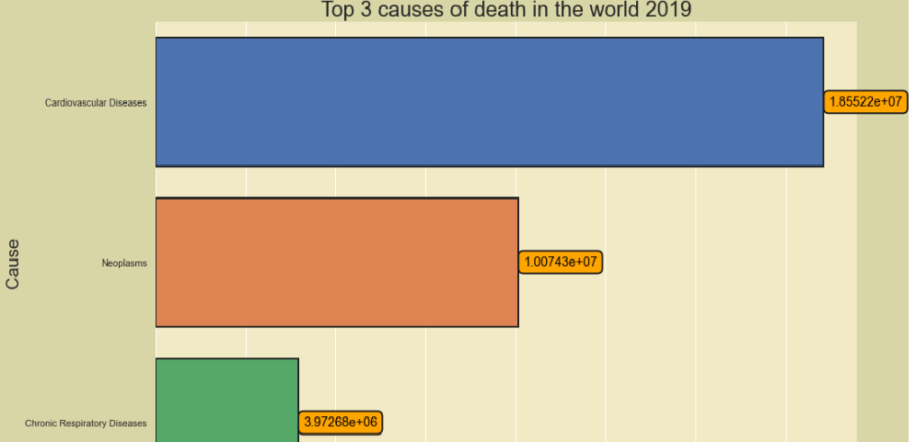
Maximum deaths are due to Cardiovasular diseases followed by Neoplasm and Chronic Respiratory diseases.

Slide 14
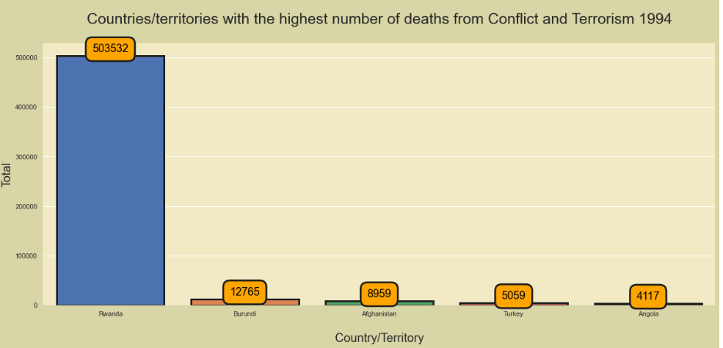
In 1994, the number of deaths from Conflict and Terrorism skyrocketed in Rwanda

Slide 15
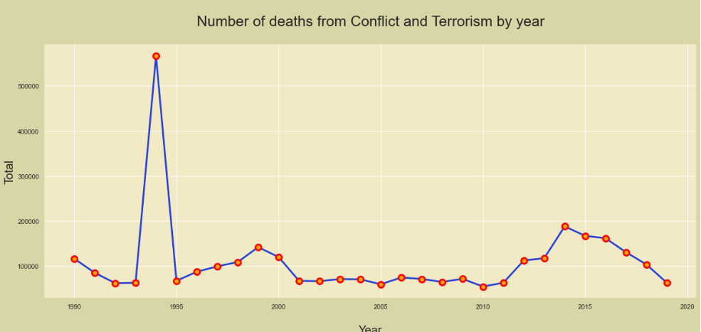
Year 1994 reported highest no of deaths by conflicts and terrorism

Slide 16
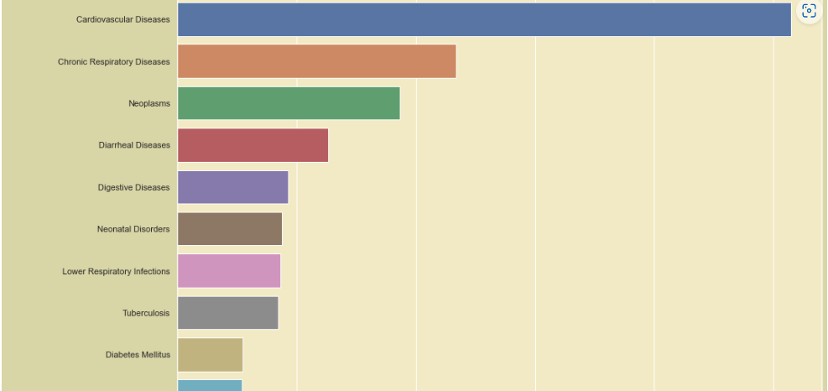
Top 10 causes of death for INDIA in 2019 (latest available year)¶
India has encountered highest number of deaths as far as Chronic respiratory diseases is concerned and very high when compared to any other nation

Slide 17
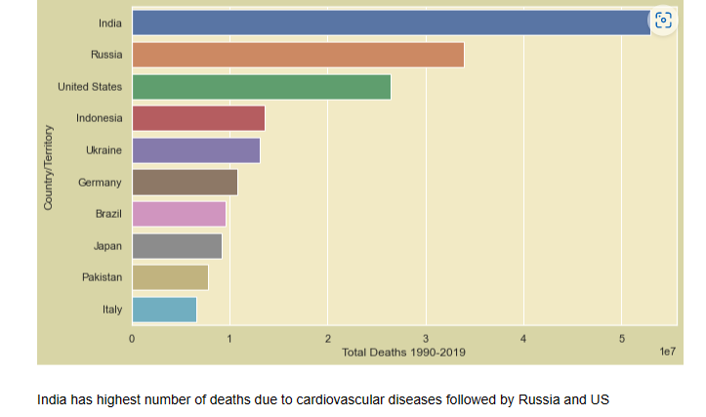
TOP 10 COUNTRIES SUFFERED FROM CARDIOVASCULAR DEATHS

Slide 18
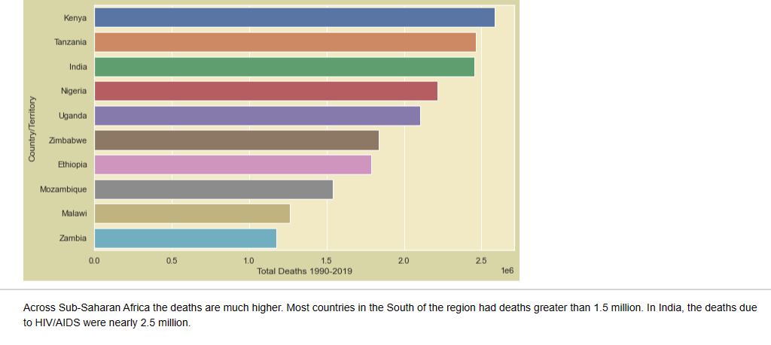
TOP 10 COUNTRIES SUFFERED FROM HIV/AIDS

Slide 19
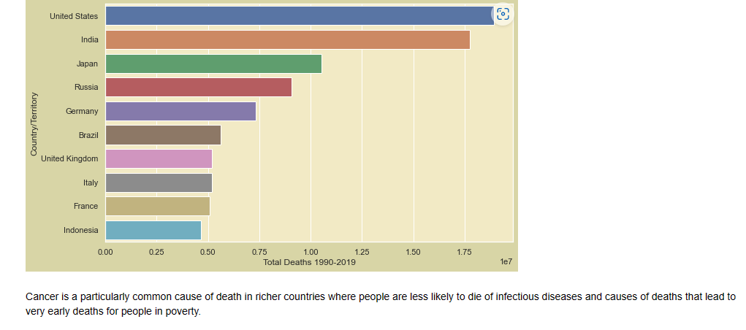
TOP 10 COUNTRIES SUFFERED FROM NEOPLASMS

Slide 20
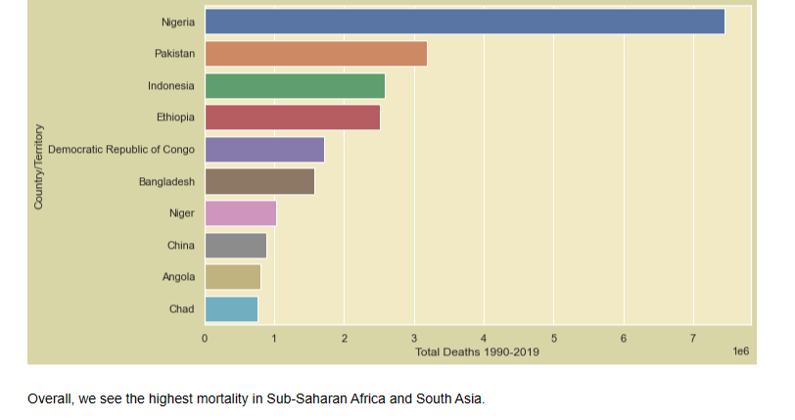
TOP 10 COUNTRIES SUFFERED FROM DIARRHEAL DISEASES

Slide 21
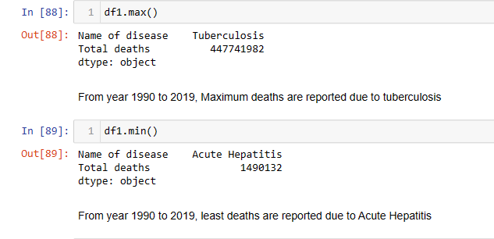
Disease wise death summary

